Slide 1

SAFETY STANDARDS AND CODES FOR GOAL-0 ACTUALISATION
IN
CONSTRUCTION SITES
BY
DEAREST EJENARHOME

Slide 2
SAFETY STANDARDS
Advisory body
Safety Standards
Regulatory body
Voluntary
Compulsory
Author- Dearest Ejenarhome MISPON, MASSP, MNiSafetyE October 2022

Slide 3
SAFETY CODES
Are the criteria agreed by organizers of Safety Standards to use to reference (decode) specific safety requirements, laws, rules and regulations. They are usually a combination of one or more of acronyms, year, number related specifically to the matter of interest
Examples are:
ISO14001
ISO45001
National Electrical Code (NEC), or NFPA 70\FMCSA
Fall Protection, construction (29 CFR 1926.501)
Respiratory Protection, general industry (29 CFR 1910.134)
Ladders, construction (29 CFR 1926.1053)
Author- Dearest Ejenarhome MISPON, MASSP, MNiSafetyE October 2022

Slide 4
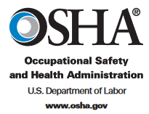
OSHA CODING SYSTEM
29 CFR 1926.501
Part Number: 1926
Part Number Title: Safety and Health Regulations for Construction
Subpart: 1926 Subpart M
Subpart Title: Fall Protection
Standard Number: 1926.501
Title: Duty to have fall protection.
GPO Source: e-CFR
Author- Dearest Ejenarhome MISPON, MASSP, MNiSafetyE October 2022

Slide 5






Voluntary Standards
Author- Dearest Ejenarhome MISPON, MASSP, MNiSafetyE October 2022

Slide 6
The International Organization for Standardization is an independent, non-governmental International organization with a membership of 167 national standard bodies, it is into development and publishing of international standards, representatives from the national standards organizations of member countries make up the body. It was founded on the 23rd of February 1947, in London UK with the headquarter in Geneva, Switzerland.
Membership requirements are given in Article 3 of the ISO Statutes.
It uses the link of its members to get experts that come together to share knowledge and develop voluntary, consensus-based, market relevant International Standards that assures innovation and provide solutions to global challenges including safety.
Author- Dearest Ejenarhome MISPON, MASSP, MNiSafetyE October 2022

Slide 7
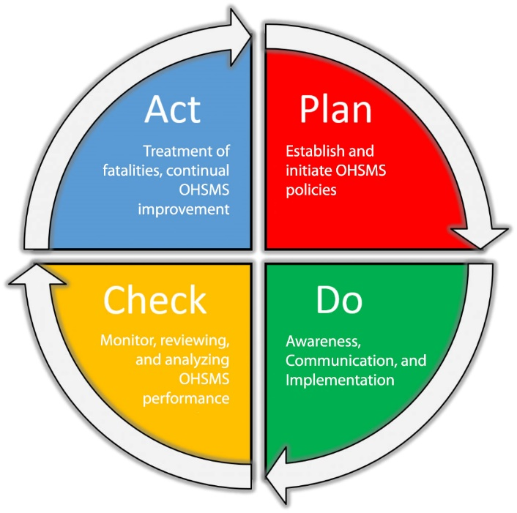
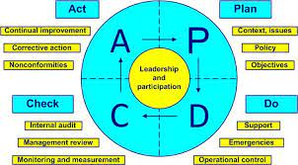
ISO 45001:2018- OHS STANDARD
Author- Dearest Ejenarhome MISPON, MASSP, MNiSafetyE October 2022

Slide 8
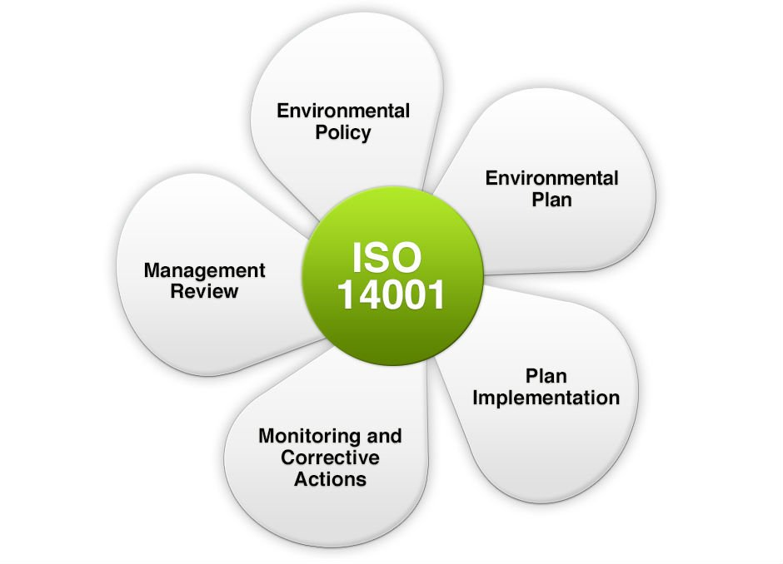
ISO 14001:2015- EMS STANDARD
Author- Dearest Ejenarhome MISPON, MASSP, MNiSafetyE October 2022

Slide 9
Statutory Standards
Author- Dearest Ejenarhome MISPON, MASSP, MNiSafetyE October 2022

Slide 10
Occupational Safety and Health Administration (OSHA) is a body under United States Department of Labor, was initiated by Occupational Safety and Health Act of 1970 (OSH Act), it was passed to ensure safety of workers and prevent them from being involved in major and/ or fatal occupational accidents. These are set of laws which enforces protective workplace, safety and health standards. OSHA is also into provision of information, training, and support to employers and workers.
OSH Act, enforces employers to create a safe workplace for her employees.
Author- Dearest Ejenarhome MISPON, MASSP, MNiSafetyE October 2022

Slide 11
TOP 10 OSHA STANDARDS
These are the top 10 most frequently cited standards following inspections of worksites by federal OSHA for all industries. This list is published by OSHA to alert employers about the most common hazards that workers get exposed to and if not corrected adequately and promptly results in preventable illnesses, injuries, disabilities and even death, thus OSHA enforce companies to take proactive measures in recognizing hazards and putting control measures to eradicate or reduce exposure to them to as low as reasonably practicable.
Fall Protection, construction (29 CFR 1926.501)
Respiratory Protection, general industry (29 CFR 1910.134)
Ladders, construction (29 CFR 1926.1053)
Hazard Communication, general industry (29 CFR 1910.1200)
Scaffolding, construction (29 CFR 1926.451)
Fall Protection Training, construction (29 CFR 1926.503)
Control of Hazardous Energy (lockout/tagout), general industry (29 CFR 1910.147)
Eye and Face Protection, construction (29 CFR 1926.102)
Powered Industrial Trucks, general industry (29 CFR 1910.178)
Machinery and Machine Guarding, general industry (29 CFR 1910.212)
CFR MEAN CODE OF FEDERAL REGULATION
Author- Dearest Ejenarhome MISPON, MASSP, MNiSafetyE October 2022

Slide 12
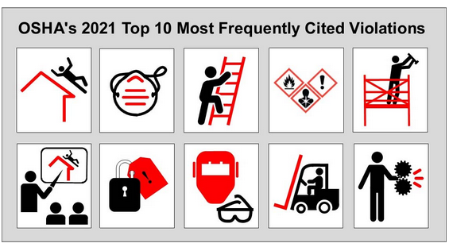
Author- Dearest Ejenarhome MISPON, MASSP, MNiSafetyE October 2022

Slide 13

Author- Dearest Ejenarhome MISPON, MASSP, MNiSafetyE October 2022

Slide 14
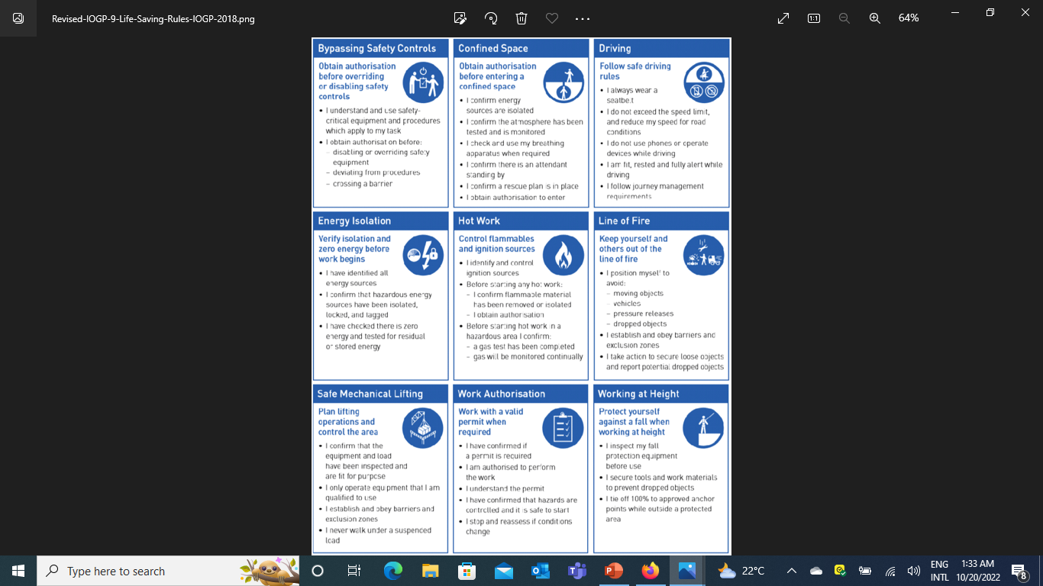
Author- Dearest Ejenarhome MISPON, MASSP, MNiSafetyE October 2022

Slide 15
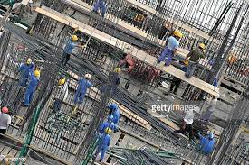
Construction Site
A place where works are done step by step (tasks) to achieve a desired intent such as accommodation, fire station building, control room, roads, Gas Plant, Effluent Treatment tanks and Plant etcetera.
Author- Dearest Ejenarhome MISPON, MASSP, MNiSafetyE October 2022

Slide 16
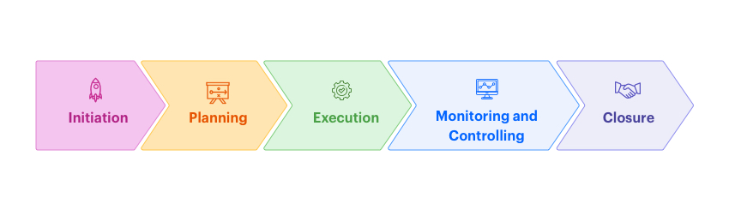
PHASES OF CONSTRUCTION PROJECTS
Planning phase.
Mobilization phase.
Execution phase.
Pre-commissioning phase.
Commissioning phase.
Site restoration phase.
Demobilization phase.
Author- Dearest Ejenarhome MISPON, MASSP, MNiSafetyE October 2022

Slide 17
PROJECT INITIATION PHASE
Ensure robust provision for HSSE at initiation phase in a manner that can adequately and provide all HSSE requirements considering manpower, tools, equipment and materials, documentations, tests, checks and processes.
Author- Dearest Ejenarhome MISPON, MASSP, MNiSafetyE October 2022

Slide 18
PLANNING PHASE
Project specific OHS Plan, EMS Plan and Security Plan and EIA.
Competent workforce.
Competence matrix.
Adequate staff strength.
Content of HSE Plan align with the HSE-MS Standard in use.
HSSE Monitoring Plan
Pre-mobilization requirements
Author- Dearest Ejenarhome MISPON, MASSP, MNiSafetyE October 2022

Slide 19
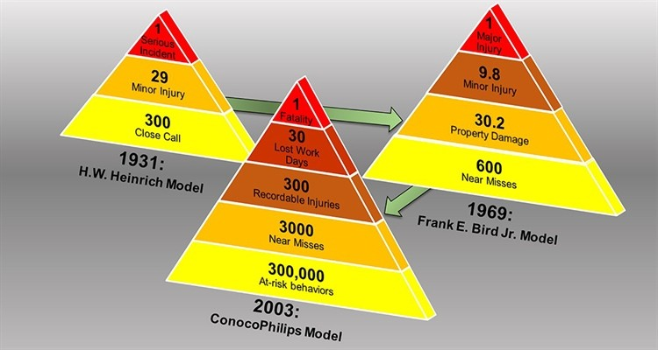
EXECUTION PHASE
S..M.A.R.T. implement all plans by
Ensure all HSSE Plans are revalidated after review periodically.
Execute all HSSE tasks and targets in the Project specific OHS, EMS and Security Plans.
Developing ‘HSSE Tasks and Targets implementation schedule’ with top management buy-in and approval.
Optimal time management.
Prompt and adequate close out of all HSSE related action items.
Develop JHA at site and update JHA based on dynamic observations,
Develop project specific ‘Risk Register’ at site.
Follow PTW Process thoroughly.
Ensure daily on-the-job site HSSE inspections are done.
Encourage everyone’s involvement in reporting UA, UC, SA, SC, NM.
Leverage on the Safety Pyramid ideology for accident prevention.
Author- Dearest Ejenarhome MISPON, MASSP, MNiSafetyE October 2022

Slide 20
PRE-COMMISSIONING PHASE
Developed Pre-Commissioning HSSE Processes with the following achieved:
  Pre-Commissioning Hazard Hunt Exercise
  Pre-Startup Safety Reviews (PSSR) Checklist.
  Pre-Commissioning HSSE Inspection.
  Establishment Pre-Commissioning Goal O Rules with 0 tolerance.
  List of LOTOs.
  Project specific Pre-Commissioning PTW Processes.
  Pre-commissioning JHA review.
Author- Dearest Ejenarhome MISPON, MASSP, MNiSafetyE October 2022

Slide 21
SITE RESTORATION PHASE
Thorough good housekeeping to make just completed project no longer look like a construction site, but facility ready for commissioning and use.
Author- Dearest Ejenarhome MISPON, MASSP, MNiSafetyE October 2022

Slide 22
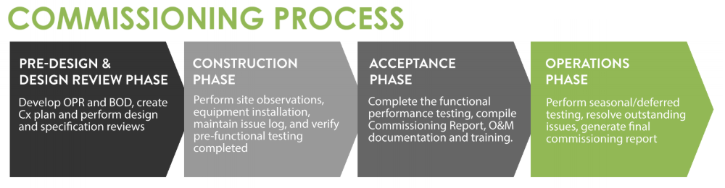
COMMISSIONING PHASE
Author- Dearest Ejenarhome MISPON, MASSP, MNiSafetyE October 2022

Slide 23
DEMOBILIZATION PHASE
Contractor remove all personnel, tools, equipment, machines, junks, materials and items from site
Author- Dearest Ejenarhome MISPON, MASSP, MNiSafetyE October 2022

Slide 24
QUESTIONS

Slide 25
END
Author- Dearest Ejenarhome MISPON, MASSP, MNiSafetyE October 2022

